Slide 1
Golf Performance
Marc Edwards, Yedin Lui, Xinzhe Qi
36-493: Sports Analytics Capstone

Slide 2
Carnegie Mellon University Golf
Head Coach
Dan Rodgers
Women’s Program
Ranked 1st
in NCAA Division III
Men’s Program
Ranked 4th
in NCAA Division III
Over 300 tournament rounds played each year
Over 200 practice rounds played each year

Slide 3
Client Goals
Leverage team golf round data to analyze team strengths and weaknesses through data visualization
Utilize R Shiny to create a user-friendly interactive dashboard

Slide 4
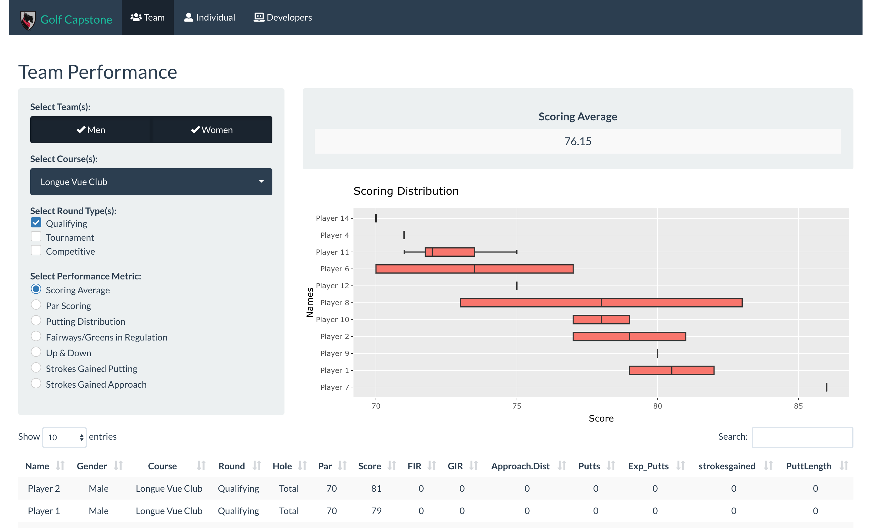

Slide 5
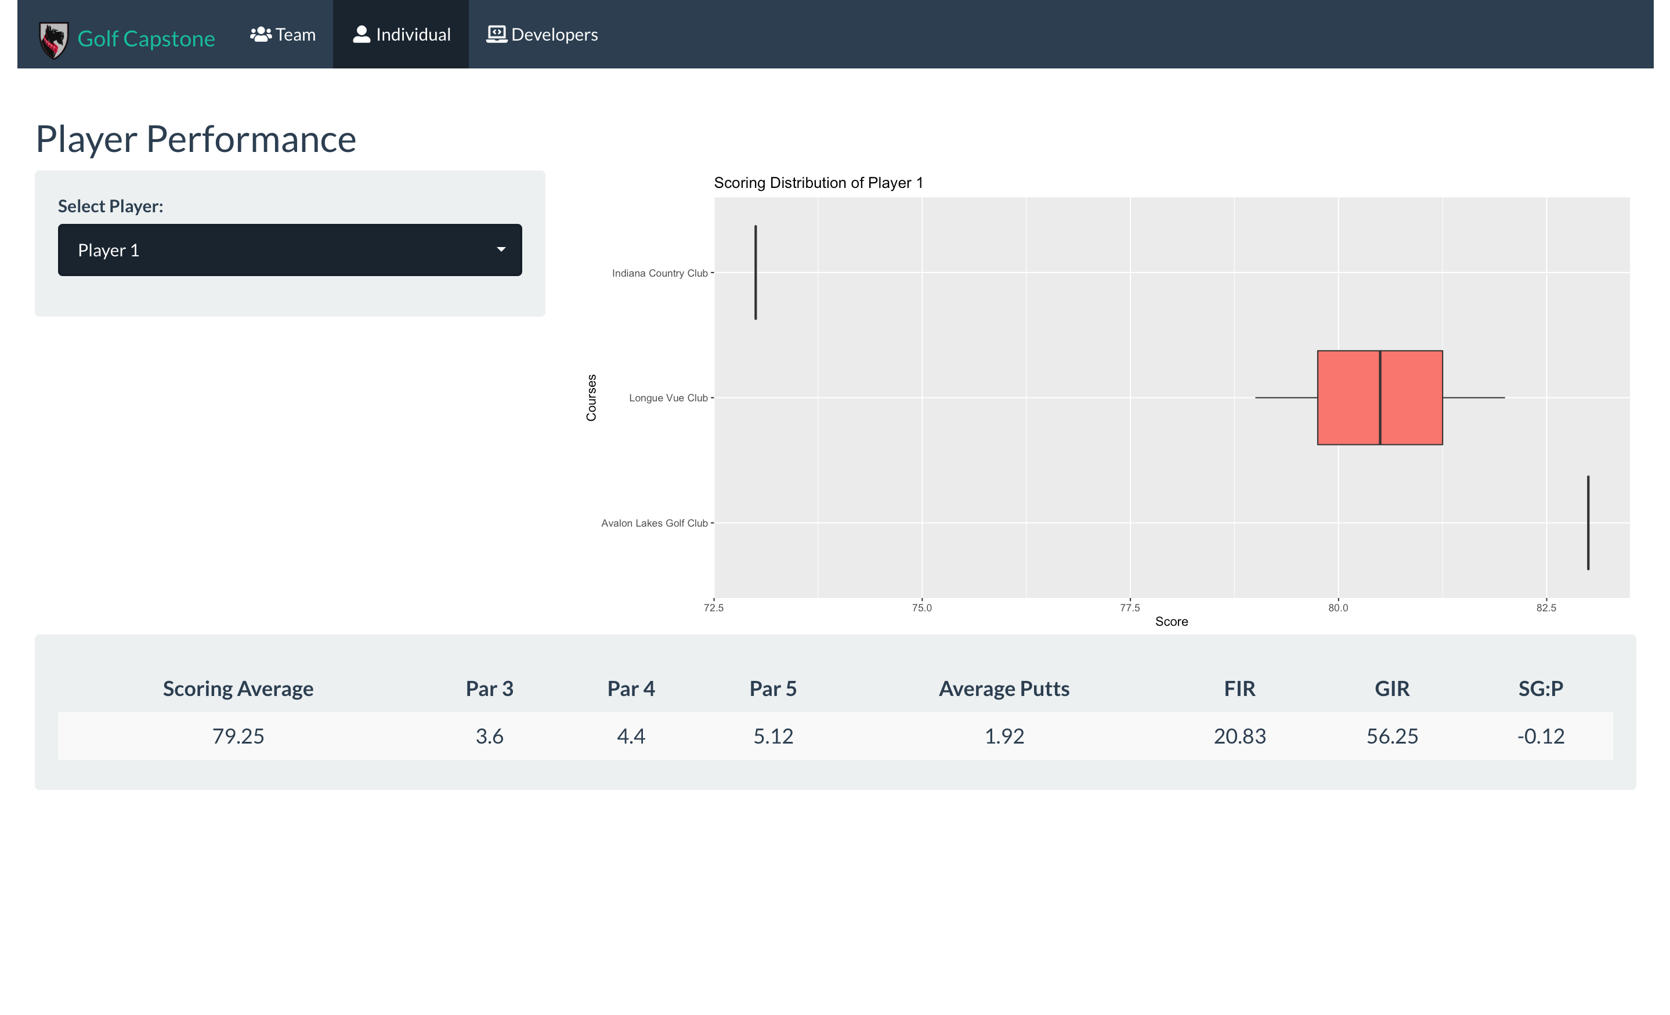

Slide 7

Thank you

